Slide 2
Review upcoming Teach-Ins and participation in WRAP Regional Haze Planning Work Group - Jay Baker and Tina Suarez-Murias

Slide 3
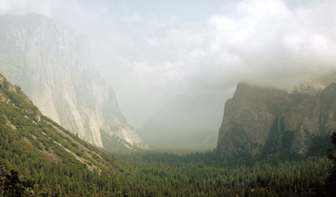
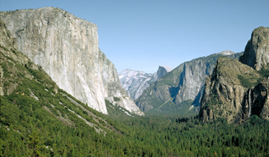
UNIFORM RATE OF PROGRESS ...AND THE GLIDE PATH – applying this conceptual planning approach
From Here?
9-15-1982
To There?
10-3-1982
WRAP Regional Haze Planning Work Group
Regional Haze Teach-In #2
July 27, 2017

Slide 4
Conceptual Planning Approach
Clean Air Act Amendments of 1977 set National Goal:
“…the prevention of any future, and the remedying of any existing impairment of visibility in mandatory class I Federal areas which impairment results from manmade air pollution.”
Focus of 1999 Regional Haze Rule: Achieve Natural Conditions by 2064
Construct a straight-line Glide Path using deciview units over time
Start point: Baseline Worst Visibility Averages for 2000-2004
End Point: Worst Visibility under Natural Conditions, assigned to 2064
Slope: the Uniform Rate of Progress
Prepare State SIP with Reasonable Progress Goals (RPGs) for each planning period
Do interim RPGs land on the Glide Path?
Why not?
Worst Haze Days Baseline
RPG
Uniform Rate of Progress
(Slope of the Glide Path)
Worst Haze Days Average for Natural Conditions
DECIVIEWS
Best Days Baseline (must not be degraded)
Baseline
(2000-2004)
2018
2064
Additional time to reach Natural Conditions at initial rate
YEAR

Slide 5
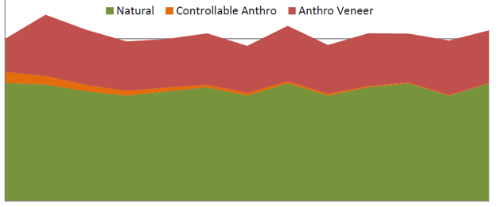
Moving from Concept to Reality
CONCEPT: Assumptions for Achieving Natural Conditions at 2064
Chemical species mass captured on IMPROVE filters, converted to deciviews, quantifies visibility
Natural Conditions are constant and expressed as deciview average for the worst haze days
All anthropogenic impacts can be eliminated, or reduced to be “not perceptible” at monitors
NCII deciview estimates assigned to 2064 can be refined by states with EPA approval
REALITY: Both Natural Conditions and Causes of Haze are changing
Natural sources in West overwhelm anthropogenic reductions on haziest days
Using 2018 RPGs calculated through modeling, Western States set RPGs above the Glide Path
Public considers Glide Path the benchmark of progress and challenged RPGs and initial URPs
Progress is not straight line; 5-year deciview averages do not reflect anthropogenic emission trends
Western visibility improvements not discernible using deciview values alone
Current western visual range on average day is ~111 miles vs. ~58 miles at eastern IMPROVE monitors
Haze Algorithm was refined and estimates of Natural Conditions will change
Climate change, global economy, and political decisions affect natural sources
Initial Concept: Eliminate Anthropogenic Impairment
Reality: Focus on reducing Controllable Anthropogenic
Uncontrollable Veneer
Deciview
Anthropogenic Haze
Deciview
(Representation of Alaskan site; each site has different mix of these three components)
Natural Haze
5

Slide 6
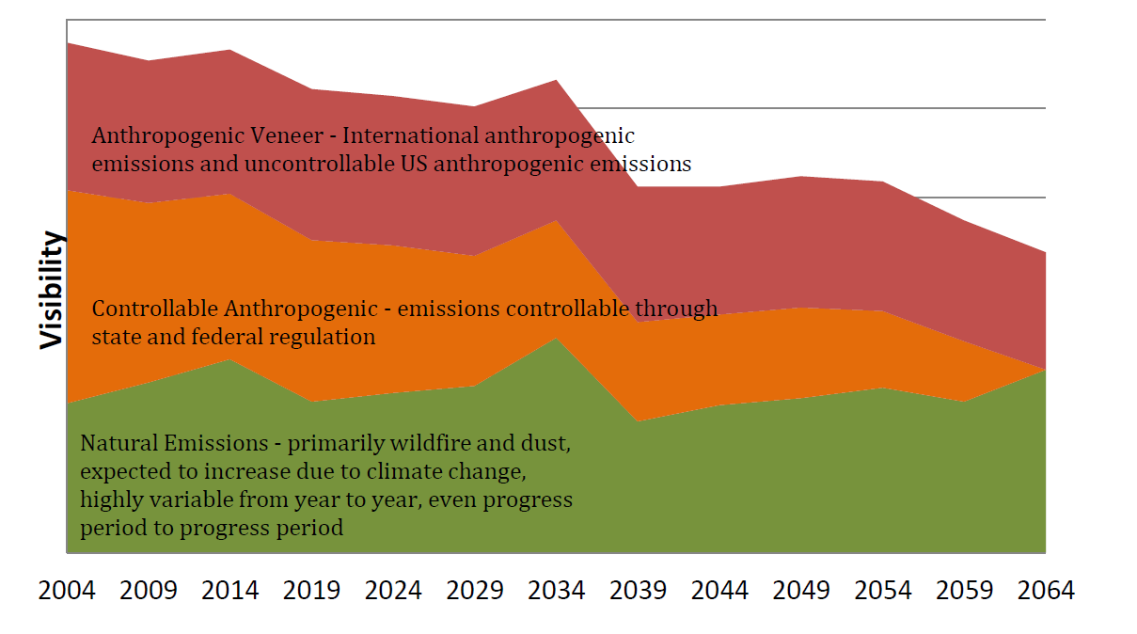
Redefining Start and End Points of Glide Path
Baseline Years remain Start Point of Glide Path
Same baseline monitoring measurements, reinterpreted for second planning period
Species contributions initially related to emission sources by modeling were quantified
Natural Contributions determined mathematically using percentiles and substitution
Idealized Glide Path still Ends at 2064, but additional adjustments allowed
What will “Natural Conditions” actually be in the future?
Is the NCII or NCIII deciview level for the Worst Haze Days from Natural Sources only?
What deciview quantity actually comes from “uncontrollable sources”?
Should “known” baseline attributions be added to end point as surrogate placeholders?
Beyond 2064, will some of the uncontrollable U.S. anthropogenic emissions become controllable with future “as-yet-unknown” technologies?
U.S. portion of this remaining uncontrollable veneer may or may not become controllable with future unknown technology?

Slide 7
Glide Path Slope vs Uniform Rate of Progress
Glide Path remains a straight-line benchmark for judging progress
Baseline (start point) and 2064 (endpoint) can change, so long-term slope changes
Baseline will be lower after adjustment to MID
2064 endpoint will be higher after adjustment for “special accounting” emissions
Will 2064 endpoint change with better information incorporated each planning period?
RPG and Uniform Rate of Progress determined for each planning period
Is progress in reducing impairment measured against the RPG or the Glide Path?
Will need some outreach to explain changes to public expectations of progress...
Adjusted endpoint
(adds components for International Emissions and Prescribed Burning to “Most Impaired Days” for Natural Conditions
2018 RPG
DECIVIEWS
Adjust Baseline starting with Days “Most Impaired” by Anthropogenic Emissions by removing impacts from extreme natural episodic events
Initial Glide Path
Best or Clearest Days
Baseline
(2000-2004)
2018
2028
2038
2048
2058
2064
YEAR
Worst Natural Haze Days (WND)
Most Anthropogenically Impacted Days (MID)

Slide 8
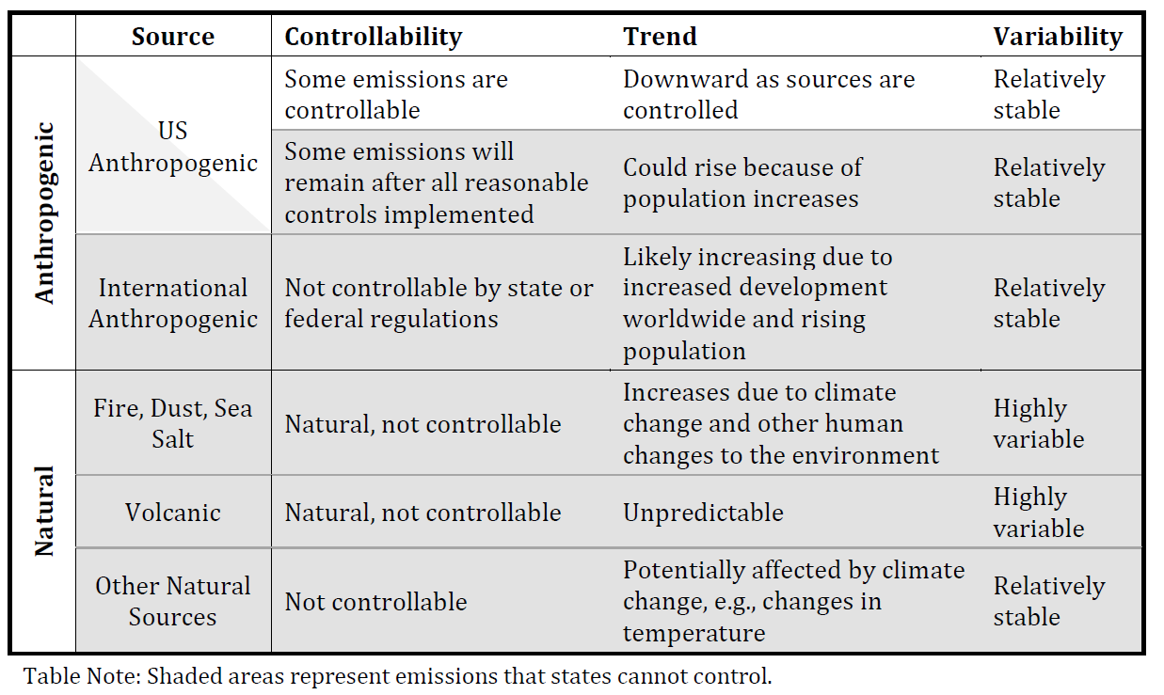
Focus on Anthropogenic Emissions
1. Define what is Anthropogenic and Controllable
SOURCE | In-State | Out-of-State | International
Anthropogenic | Controllable | not controllable | not controllable
Natural | not controllable | not controllable | not controllable
2. Quantify all the emissions contributions on a daily basis for modelling
Figure out relationship between source type and species light extinctions on a daily basis for modelling

Slide 9
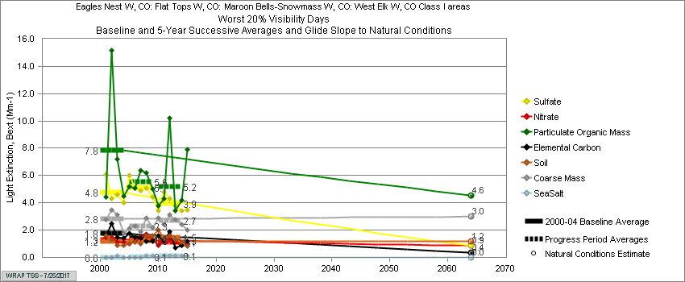
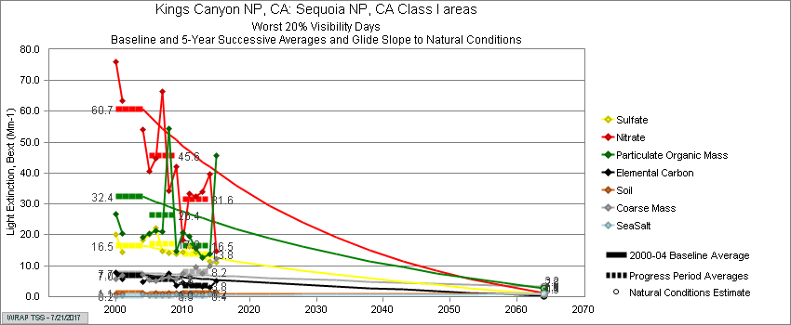
Species’ Light Extinctions vs Source Contributions
Light Extinction Strength does not match relative mass emissions inventory
Per unit of mass: light extinction EC > OC > Nitrate > Sulfate > Fine Soil > Sea Salt > Coarse Mass
Species Extinction driving Highest Deciview Days in Western baselines different at each monitor
Mostly OC, Nitrates, Sulfates, and Coarse Mass
Some natural & some anthropogenic; international sources generate both
Baseline Composition is different on Most Anthropogenically Impaired Days (MIDs)
Expect Nitrates and Sulfates to dominate; perhaps some OC also
Future Natural Conditions (Worst Natural Haze Days) also estimated by Species Light Extinction
Expect Natural OC, Coarse Mass, and Fine Soil to be predominant in West
Is “NCII” (2064 endpoint) realistic? (circa 10 ug/m3 PM10 in top quintile of Worst Natural Haze Days!)
Is endpoint sum of highest quintile for natural sources of haze?
How should we quantify international and prescribed fire adjustments to “correct” Natural Conditions?
What about remaining uncontrollable U.S. anthropogenic emissions?
9.4 >>> 8.0 ug mass
31.3 >>> 7.8 ug mass
Farthest Baseline Average Visibility 149 miles for All Days
Shortest Baseline Average Visibility 93 miles for All Days

Slide 10
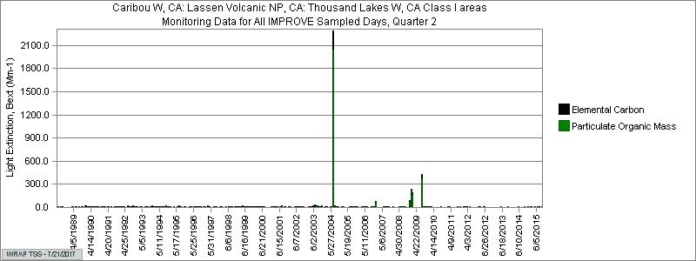
Challenges in Resetting Baseline
Species by species analysis time-consuming, but needed to select percentile
Compare every year of available data, bay annual average and by every day (for seasonality information)
Is 95th percentile correct for the specific site for specific species?
Or any site for any particular year?
Need protocol for daily substitution in days identified with e3 (above selected percentile)
Seasonal mean? Long-term average? 1x, 2x, 3x median for particular year?
Should every state use both OC+EC along with CM+FS
Will residential woodsmoke show up?
Will prescribed fire show up in wildfire percentile?
Will construction event show up in CM+FS record?
Will Hawaii be able to pinpoint volcanic emissions using percentile alone?
What to do with sites having <3 years of complete data?
Data substitution? Include 2005 or later?
Understand site context and history, in addition to math!
Relatively remote site, high elevation, longest data record in California shows change

Slide 11
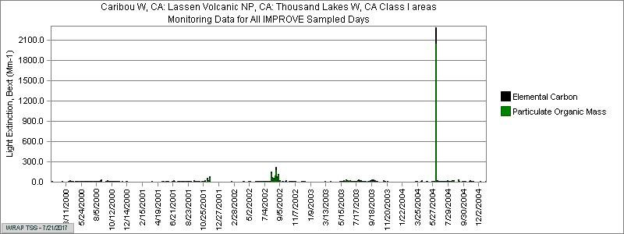
Lassen Volcanic Case Study: 95th Percentile
Compare seasonality with known fires and timing of prescribed burns.
2000 - no wildfires?
2001 - prescribed fires?
2002 - not all of Biscuit Fire?
2003 - maybe no wildfires
2004 - single day spike May 2004
If examined season by season, more likely that 15-30 Mm-1 could be prescribed fires, but over 30 Mm-1 is very likely associated with wildfire smoke – need consultation with Federal Land Managers for confirmation!

Slide 12
Possible Changes in Outcomes
Worst Haze Days
Light Extinction 2012
Initial
Baseline
Modeled 2018 RPG Extinction
Potential corrections for MID
Each monitor will have new MID baseline dv and long-term Glide Path to adjusted 2064 dv
Within each planning period, the interim URP slope will change
In theory, URP Slope based on 2014 MID dv start and 2028 MID dv forecast
Or, should we model for Worst Haze Days, adjust 2064, and use MID to measure progress?

Slide 13
Modeling Challenge: Matching Reality
All species unacceptably under-predicted for 2011 base year modeling at SEQU.
How were baseline and NCIII calculated as start and finish of New Glide Path?
Base year projections from 2011 – is West using 2014 as base year for 2028 forecast?
Does 2028 forecast assume natural emissions are the same as 2011 (17-yr. span?)

Slide 14
Progress Report for 2018
Use Initial Glide Path and 2018 RPG calculation
Worst Haze Days Average for 2014-2018 (5-yr. avg.)
Compare with modeled 2018 RFP from initial RH SIP
Maintain consistency with WHD metric because modeling for 2018 RPGs attempted to account for uncontrollable factors
Top quintile includes natural & anthropogenic haze
Review benefits of BART controls after implementation
Verify emissions reductions of relevant precursors
Explain light extinction changes observed on Worst Days for species
Explain whether deciview reduction is discernible
Potential reasons for differences from modeled 2018 RPGs
Unexpected growth/decline of species in emissions forecast
Natural sources emissions different than predicted (e.g. baseline average held constant for wildfires)
Boundary Conditions changed due to global economy shifts or climate change
Confirm Best or Clearest Days from Baseline are maintained
Optional: Compare Visual Range on all days and publicize benefits
Remember: the human eye detects haze at particle concentrations well below the NAAQS health standards!

